Slide 1

Instruction Set Architecture Simulator using Python and Tkinter
Jayanth Sattineni

Slide 2
Introduction
Purpose of the Presentation:
"The main aim of this presentation is to discuss the development and functionality of an ISA Simulator built using Python and Tkinter.”
Overview of the Project:
"This project aims to provide a tool for understanding and demonstrating basic computer architecture through simulation of an Instruction Set Architecture (ISA)."

Slide 3

Project Objectives
Educational Tool:
"To serve as an interactive educational platform for students learning the principles of computer architecture and instruction sets.”
Software Development:
"To provide developers a sandbox environment for testing and debugging assembly level programs."

Slide 4
Technical Overview
Languages and Technologies Used:
"Python: Utilized for its simplicity and powerful libraries, handling the backend logic of the simulation."
"Tkinter: Used to create the graphical user interface, enabling interactive simulation control and visualization."
Architecture Brief:
"The simulator is designed to mimic a simple custom ISA, capable of handling basic arithmetic operations.

Slide 5
ISA and Supported Instructions
List of Instructions:
”MOV: Moves or loads a value directly into a register.”
”ADD: Adds two register values and stores the result in another register.”
”SUB: Subtracts the second register value from the first and stores the result in another register."
”MUL: Multiplies two register values and stores the result in another register.”
”DIV: Divides the first register value by the second and stores the result in another register."
“HALT: Terminates the program execution.”

Slide 6
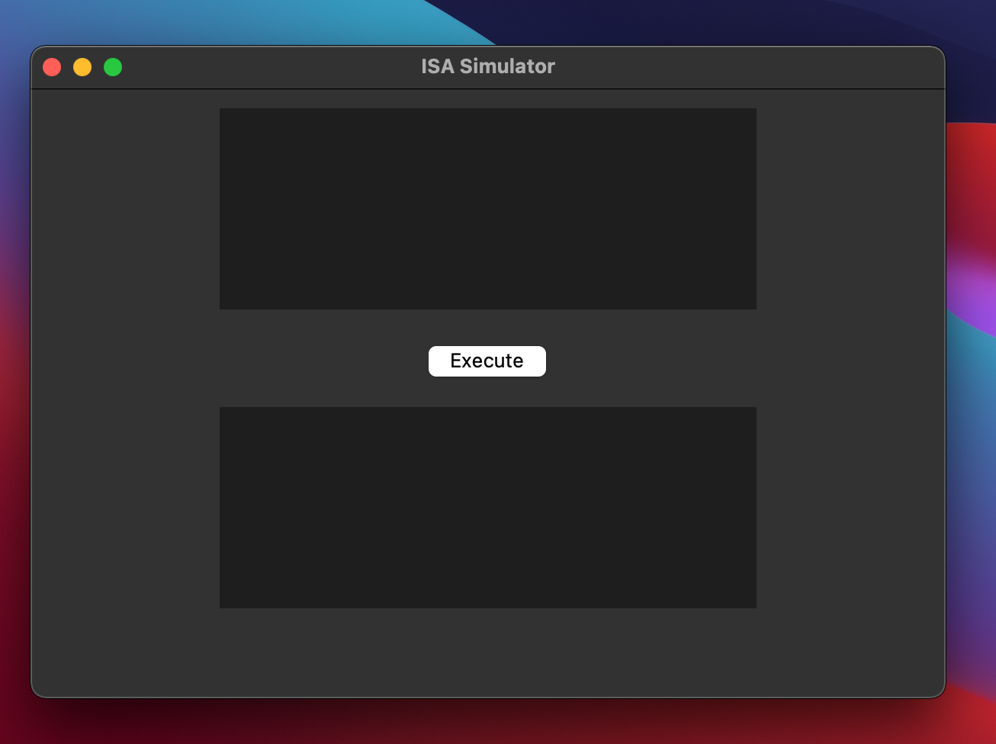
User Interface
Explanation of UI Components:
"Text Area for code input, button for executing the input commands, and display area after performing the operations.

Slide 7
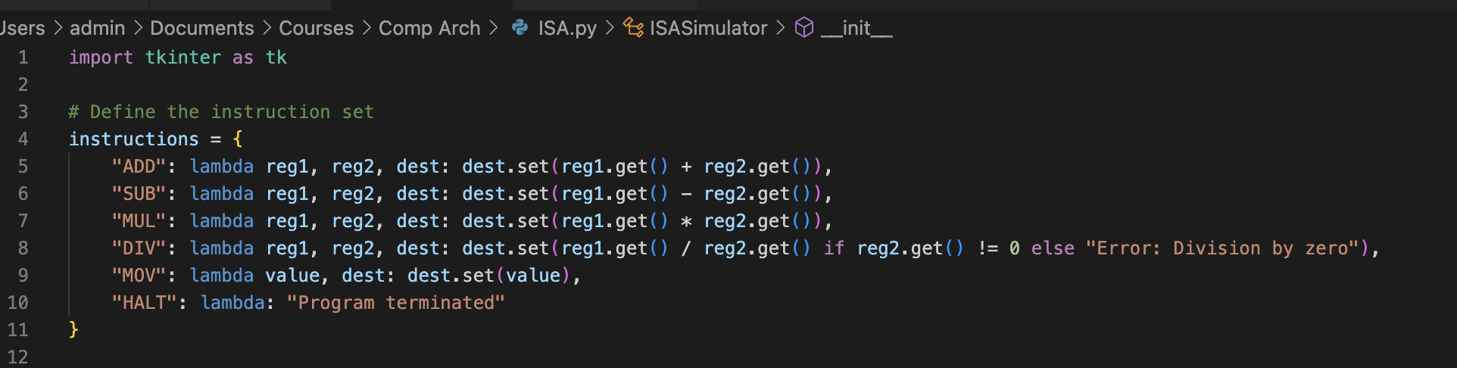
Code

Slide 8
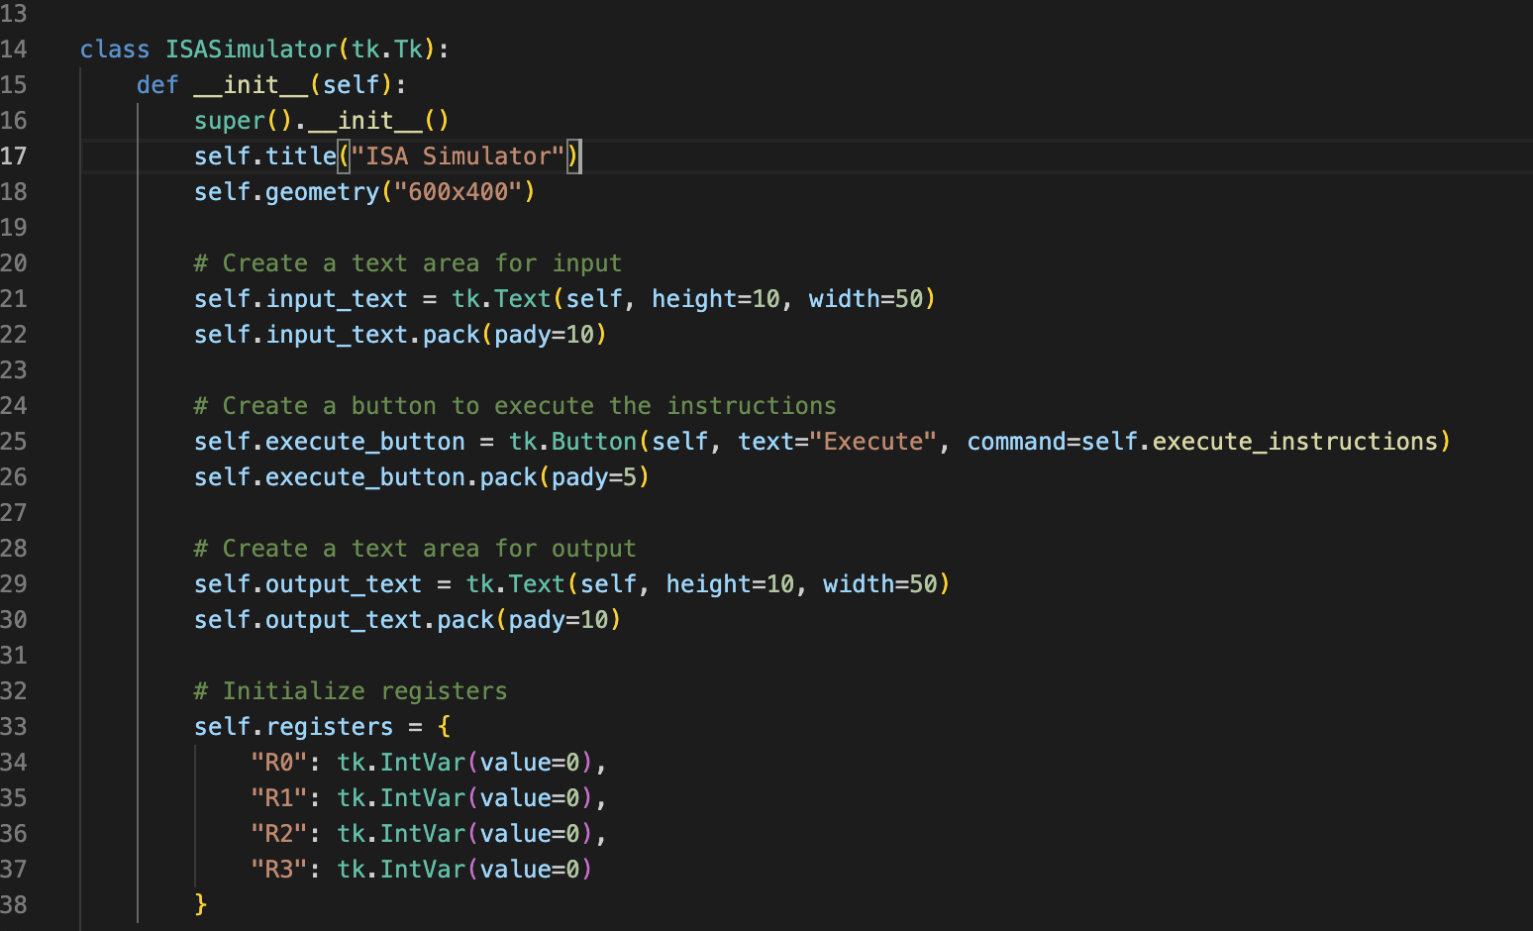
Code

Slide 9
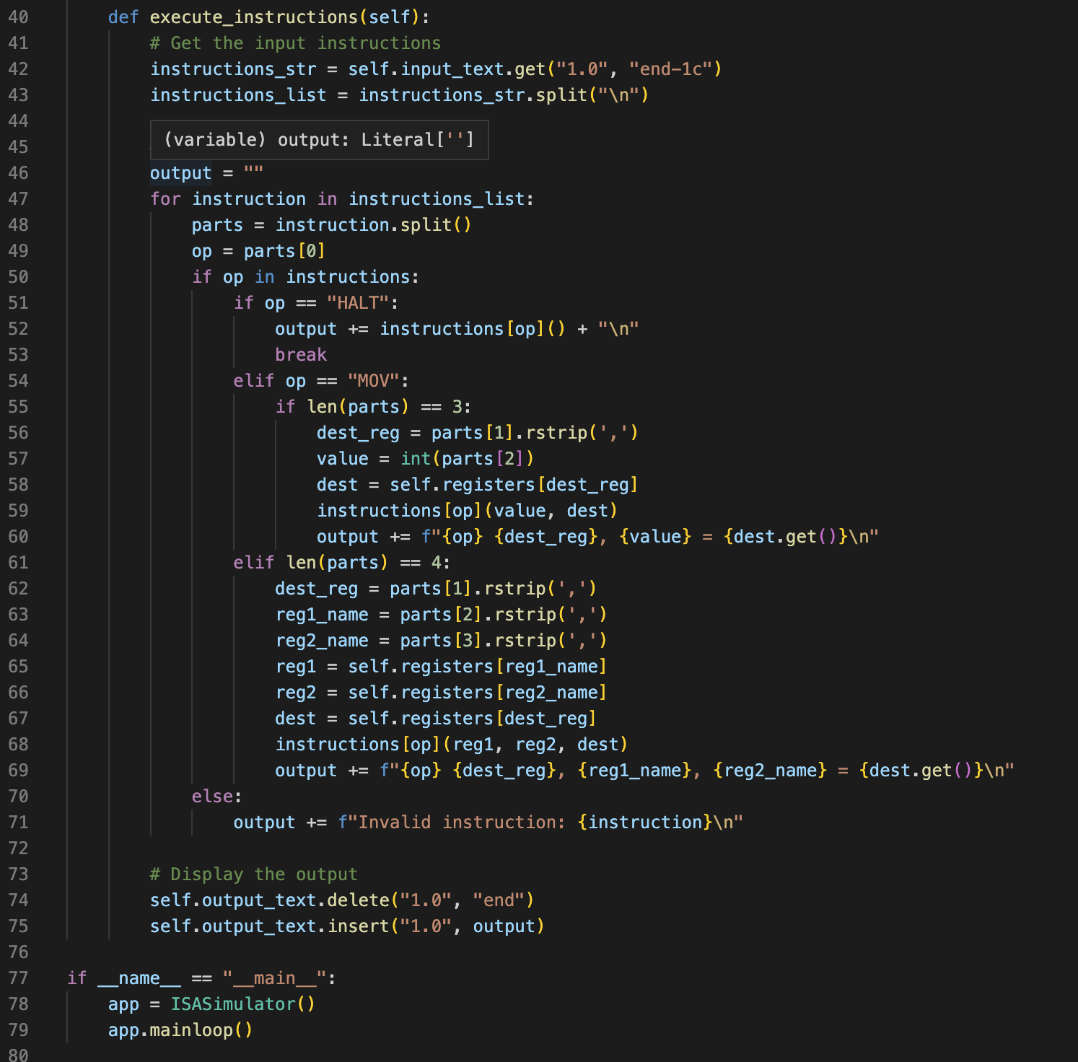
Code

Slide 10
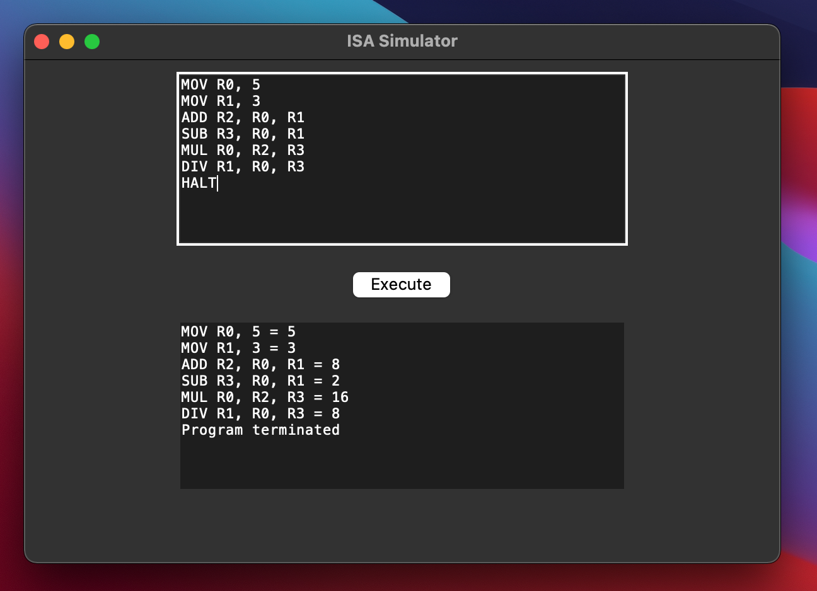
Output

Slide 11
Future Enhancements
Potential Improvements:
"Adding support for more complex ISA features, enhancing user interaction through additional GUI improvements."
Expansion Ideas:
"Introduction of more advanced debugging tools and instructional features to aid in educational settings."

Slide 12

Thank You

